Slide 1
Microservice Design Patterns

Slide 2
Service Discovery

Slide 3
What is Service Discovery?
The Service Discovery mechanism helps us know where each instance is located.
A Service Discovery component acts as a registry in which the addresses of all instances are tracked.
The instances have dynamically assigned network paths.
Consequently, if a client wants to make a request to a service, it must use a Service Discovery mechanism.

Slide 4
The Need for Service Discovery
Dynamically determining the location of an application service isn’t a trivial matter.
Things become more complicated when we consider an environment where we’re constantly destroying and distributing new instances of services.
This may well be the case for a cloud-based application that’s continuously changing due to horizontal autoscaling to meet peak loads, or the release of a new version.
Hence, the need for a Service Discovery mechanism.

Slide 5
How Does Service Discovery Works?
Service Discovery handles things in two parts.
First, it provides a mechanism for an instance to register and say, “I’m here!”
Second, it provides a way to find the service once it has registered.

Slide 6
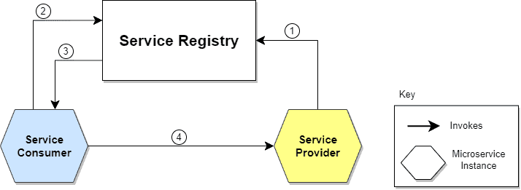
Communication flow between Service Consumer and Service Provider.
The location of the Service Provider is sent to the Service Registry (a database containing the locations of all available service instances).
The Service Consumer asks the Service Discovery Server for the location of the Service Provider.
The location of the Service Provider is searched by the Service Registry in its internal database and returned to the Service Consumer.
The Service Consumer can now make direct requests to the Service Provider.

Slide 7
Service Discovery patterns
Client‑Side Discovery
Server‑Side Discovery

Slide 8
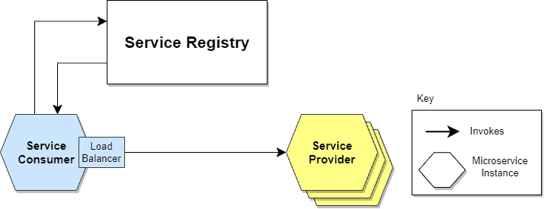
Client-Side Service Discovery
Service Consumer is responsible for determining the network locations of available service instances and load balancing requests between them.
The client queries the Service Register.
Then the client uses a load-balancing algorithm to choose one of the available service instances and performs a request.

Slide 9
Advantage & Disadvantage of Client Side Discovery
It’s an advantage because it saves an extra hop that we would’ve had with a dedicated load balancer.
It’s a disadvantage because the Service Consumer must implement the load balancing logic.
Client-Side Discovery logic must be implemented for each programming language and framework used by the Service Consumers.

Slide 10
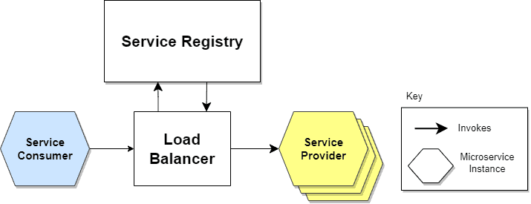
Server-Side Service Discovery
It uses an intermediary that acts as a Load Balancer.
The client makes a request to a service via a load balancer that acts as an orchestrator.
The load balancer queries the Service Registry and routes each request to an available service instance.

Slide 11
Advantage & Disadvantage of Server Side Discovery
As a dedicated actor, the Load Balancer, does the job of load balancing. This is the main advantage of this approach. Indeed, creating this level of abstraction makes the Service Consumer lighter, as it doesn’t have to deal with the lookup procedure. As a matter of fact, there’s no need to implement the discovery logic separately for each language and framework that the Service Consumer uses.
Disadvantage is that we must set up and manage the Load Balancer, unless it’s already provided in the deployment environment.

Slide 12
How does this registration and de-registration operation of microservice in Service Registry take place?
The Service Register is a crucial part of service identification.It’s a database containing the network locations of service instances.
A Service Registry must be highly available and up-to-date.
Clients can cache the network paths obtained from the Service Registry; however, this information eventually becomes obsolete, and clients won’t reach the service instances.
Consequently, a Service Registry consists of a cluster of servers that use a replication protocol to maintain consistency.

Slide 13
Service Registration Options
Self-Registration
Third-party Registration

Slide 14
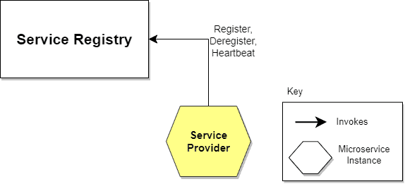
Self-Registration
When using the self-registration model, a service instance is responsible for registering and de-registering itself in the Service Registry.
In addition, a service instance sends heartbeat requests to keep its registration alive.
This model is preferred because of its simplicity and independence. It won’t require any other system entities to proceed. But, as it integrates the service instance into Service Registry, things become complex. It asks for registration code implementation for every used framework and language.

Slide 15
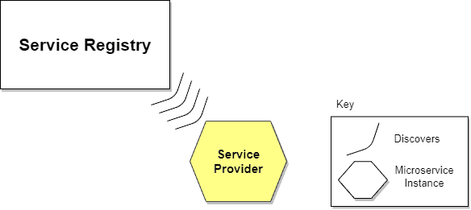
Third-party Registration
Service instances aren’t responsible for registration in the Service Registry. Instead, another system component known as the Service Register is responsible for registration.
The Service Register keeps track of changes to running instances by polling the deployment environment or subscribing to events.
When it detects a newly available service instance, it records it in its database.
The Service Registry also de-registers terminated service instances.
Advantages is that services are decoupled from the Service Registry. There’s no need to implement service registration logic for each programming language and framework. Instead, the registration of service instances is managed centrally within a dedicated service. Disadvantage of this model is that, unless it’s embedded in the deployment environment, it’s yet another highly available system component that needs to be set up and managed.

Slide 16
Circuit Breaker Pattern

Slide 17
What’s the Circuit Breaker Pattern?
The circuit breaker pattern is a design pattern used to detect and manage failures gracefully in a distributed system.
It monitors communication between microservices and temporarily halts requests to a failing service, giving it time to recover.
This helps avoid further strain on the failing service and prevents a domino effect.
It helps us determine whether the downstream service functions correctly by monitoring service interactions.
If not, the circuit breaker trips and subsequent requests are either rejected or redirected, ensuring system stability.

Slide 18
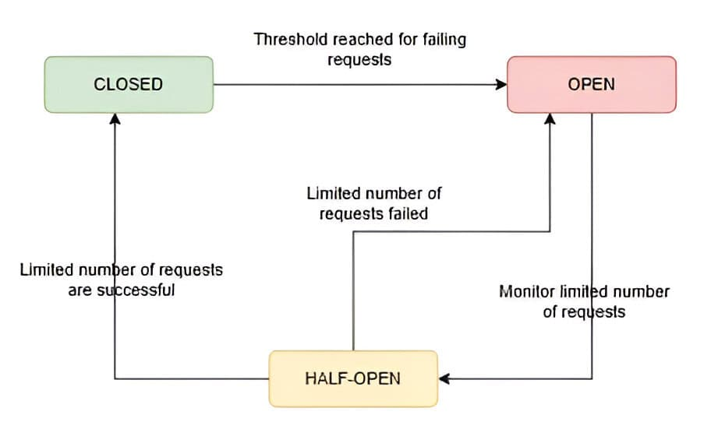
How Does the Circuit Breaker Work?
The circuit breaker operates in three states: closed, open, and half-open.
The circuit breaker starts in the closed state, allowing requests to pass through to the service. Meanwhile, as requests are processed, the circuit breaker monitors for failures. If the number of failed requests exceeds a predefined threshold within a specific time window, the circuit breaker transitions to the open state.
After a timeout period, the circuit breaker moves to the half-open state. In this state, a limited number of requests are allowed to pass through. If these requests succeed, the circuit breaker returns to the closed state. However, if these requests fail, the circuit breaker remains in the open state for another timeout period. This prevents the system from sending further requests to the failing service.
Finally, if the limited number of requests in the half-open state are successful, the circuit breaker transitions back to the closed state.
By monitoring and transitioning between these states, we can ensure minimal disruption during service failures.

Slide 19
Implementation of Circuit Breaker
Netflix’s Hystrix was a popular library for this purpose, though it has since been deprecated. However, alternatives like Resilience4j and Spring Cloud Circuit Breaker are now commonly used. These libraries allow developers to configure the pattern with minimal effort, including parameters like failure thresholds, timeout durations, and recovery mechanisms.

Slide 20
Advantages and Challenges
The circuit breaker pattern is primarily used to improve a system’s resilience and fault tolerance. It helps avoid resource exhaustion by preventing repeated attempts to connect to a failing service. Thus, it fails fast rather than allowing prolonged delays.
This pattern also aids in system monitoring by offering valuable insights into the performance and reliability of services.
However, implementing a circuit breaker comes with challenges. Fine-tuning thresholds and timeouts requires a deep understanding of service behavior, as misconfigurations can cause unnecessary trips and degrade performance. The pattern also assumes services will recover over time, which may not always be the case.
Additionally, circuit breakers may add complexity to system design, requiring mechanisms to handle false positives and fallback strategies, such as caching or default responses, to enhance resilience.

Slide 21
Bulkhead Pattern

Slide 22
What is Bulkhead Pattern?
The Bulkhead Pattern is a design principle used in software architecture to improve system resilience by isolating components or resources within a system. It is named after the watertight compartments ("bulkheads") on ships, which prevent flooding in one area from affecting the entire vessel.
In software, the Bulkhead Pattern involves partitioning components or resources into separate "bulkheads" to limit the impact of failures or overloads in one area on the rest of the system.
This isolation helps prevent cascading failures and ensures that a failure in one part of the system does not bring down the entire system.
Common implementations of the Bulkhead Pattern include using separate thread pools, processes, or containers to isolate and manage resources for different components or services within a system.

Slide 23
Importance of Isolation in System Design
Fault Containment: Isolation helps contain faults or failures within specific components or modules, preventing them from spreading and affecting other parts of the system. This containment minimizes the impact of failures, reduces downtime, and maintains overall system stability.
Resilience and Reliability: By isolating components, systems can better withstand unexpected failures, errors, or external disruptions. Isolation limits the blast radius of failures, allowing unaffected components to continue functioning normally and reducing the likelihood of widespread system outages.
Performance Optimization: Isolation enables system designers to optimize performance by allocating resources (such as CPU, memory, and network bandwidth) more efficiently. By isolating resource-intensive tasks or services, systems can avoid contention and ensure consistent performance across different components.

Slide 24
Importance of Isolation in System Design
Security Enhancement: Isolation enhances security by reducing the attack surface and limiting the propagation of security vulnerabilities or breaches. Isolating sensitive data, privileged operations, or critical infrastructure components helps mitigate the risk of unauthorized access, data leaks, and system compromises.
Scalability and Flexibility: Isolation facilitates system scalability and flexibility by decoupling components and services, allowing them to be scaled independently. This modular approach to design enables systems to adapt to changing workload demands, deploy new features, and integrate with third-party services more easily.

Slide 25
Resilience and Fault Isolation of Bulkhead Pattern
Resilience
The Bulkhead Pattern improves system resilience by limiting the impact of failures or faults in one part of the system on other components. Each compartment acts as a "bulkhead," containing faults within its boundaries and preventing them from spreading to other parts of the system. This containment helps ensure that failures in one compartment do not lead to widespread system outages or disruptions.
Fault Isolation
By isolating components or services, the Bulkhead Pattern helps identify and isolate faults, errors, or failures within specific compartments. If a failure occurs in one compartment, it remains contained within that compartment and does not affect the operation of other compartments. This isolation enables teams to diagnose, troubleshoot, and address faults more effectively, reducing the risk of cascading failures and minimizing downtime.
Overall, the Bulkhead Pattern enhances system resilience and fault isolation by containing failures within compartments, isolating faults, managing resources effectively, and supporting scalability.

Slide 26
Purpose and Benefits of Bulkheading
The purpose of bulkheading, often implemented through the Bulkhead Pattern, is to enhance system resilience and fault tolerance by isolating components or resources within a system. This isolation serves several key purposes and offers various benefits:
Fault Containment: Bulkheading helps contain faults or failures within specific compartments or boundaries, preventing them from spreading to other parts of the system. This containment limits the impact of failures, reduces downtime, and maintains overall system stability.
Resource Management: Bulkheading facilitates better resource management by allocating resources separately for each compartment. This isolation prevents resource contention between compartments, ensuring that failures or heavy loads in one area do not impact the performance of other areas.

Slide 27
Purpose and Benefits of Bulkheading
Scalability: Bulkheading supports system scalability by allowing compartments to be scaled independently based on workload demands or resource requirements. This modular approach to scaling enables teams to expand capacity or add new compartments without affecting the operation of existing compartments.
Performance Optimization: By isolating components or services, bulkheading helps optimize system performance by preventing bottlenecks and ensuring consistent performance across different compartments. Each compartment can be optimized independently to meet specific performance requirements.
Security Enhancement: Bulkheading enhances security by limiting the propagation of security vulnerabilities or breaches. Isolating sensitive components or resources reduces the attack surface and mitigates the risk of unauthorized access or data leaks.

Slide 28
Example of Bulkhead Implementation
An example of Bulkhead Pattern implementation can be seen in a web application where different types of tasks are processed by separate thread pools to ensure fault isolation and prevent resource contention.
For Example:
Let's consider a web application that handles both user-facing HTTP requests and background processing tasks, such as sending emails or processing data.

Slide 29
Example of Bulkhead Implementation
To implement bulkheading, we can use separate thread pools for handling these different types of tasks:
User-Facing Requests: We can allocate a dedicated thread pool to handle incoming HTTP requests from users. This thread pool is responsible for processing user interactions, generating responses, and returning results to clients.
Background Processing Tasks: Another dedicated thread pool is used to handle background processing tasks, such as sending emails, processing data, or performing scheduled jobs. This thread pool is responsible for executing these tasks asynchronously without blocking the user-facing request processing.

Slide 30
Here's how the Bulkhead Pattern is implemented in this scenario:
Fault Isolation: If a failure occurs in one thread pool (e.g., a task throws an exception), it remains contained within that thread pool and does not affect the operation of the other thread pool. For example, if a background processing task encounters an error, it does not impact the handling of user-facing requests.
Resource Management: Each thread pool is allocated a specific number of threads and resources based on the expected workload and resource requirements. This ensures that failures or heavy loads in one thread pool do not exhaust resources needed by the other thread pool, preventing resource contention and performance degradation.
Scalability: The thread pools can be scaled independently based on workload demands or resource availability. For example, if the background processing tasks require more resources due to increased workload, the size of the background processing thread pool can be dynamically adjusted without affecting the user-facing request handling.

Slide 31
Types of Bulkheads in Software Systems
Thread Pool Bulkhead
In multithreaded applications, a thread pool bulkhead involves allocating separate thread pools for different types of tasks or operations. For example, user-facing requests may be processed by one thread pool, while background processing tasks are handled by another.
This isolation prevents resource contention and ensures that failures or performance issues in one thread pool do not affect the operation of others.
Service Bulkhead
In distributed systems, a service bulkhead involves isolating services or microservices from one another to prevent cascading failures.
Each service operates independently and has its own resources and dependencies. This isolation helps contain faults within individual services and prevents failures from propagating across the entire system.

Slide 32
Types of Bulkheads in Software Systems
Database Bulkhead
In database-intensive applications, a database bulkhead involves partitioning databases or database connections to isolate different types of data or workload. For example, read-heavy and write-heavy operations may be directed to separate database instances or partitions.
This isolation prevents performance bottlenecks and ensures that failures or slowdowns in one database do not impact other database operations.
Network Bulkhead
In networked applications, a network bulkhead involves segregating network traffic or communication channels to isolate different types of data or services.
For example, high-priority traffic may be routed through dedicated network paths, while low-priority traffic is routed through separate paths. This isolation helps prioritize critical traffic and prevent congestion or failures from affecting other network activities.

Slide 33
Types of Bulkheads in Software Systems
Process Bulkhead
In process-based architectures, a process bulkhead involves running separate processes or containers to isolate different components or services.
Each process operates within its own runtime environment and has its own resources and dependencies. This isolation helps contain faults within individual processes and prevents failures from affecting other parts of the system.
Resource Bulkhead
In resource-intensive applications, a resource bulkhead involves partitioning resources such as CPU, memory, or storage to prevent overutilization and ensure fair resource allocation.
For example, CPU cores may be assigned to specific tasks or services to prevent one task from monopolizing resources and starving others.

Slide 34
Design Considerations for Bulkhead Implementation
Identify Components for Bulkheading:
Determine which components or resources within the system should be isolated using the Bulkhead Pattern.
This may include services, processes, databases, thread pools, or network communication channels.
Consider factors such as fault tolerance requirements, performance characteristics, and dependencies between components.
Define Boundaries and Interfaces:
Clearly define the boundaries and interfaces between bulkheads to establish isolation and communication protocols.
Determine how data, requests, or resources will flow between bulkheads and enforce separation to prevent interference or dependency between isolated components.

Slide 35
Design Considerations for Bulkhead Implementation
Allocate Resources Appropriately:
Allocate resources (such as threads, memory, CPU, database connections) to each bulkhead based on its workload, performance requirements, and fault tolerance objectives.
Ensure that each bulkhead has sufficient resources to operate effectively without impacting the performance or stability of other bulkheads.
Monitor and Manage Resource Usage:
Implement monitoring and management mechanisms to track resource usage and detect anomalies or overloads within bulkheads.
Use metrics, logs, and alerts to identify resource contention, bottlenecks, or failures, and take appropriate actions to rebalance resources or mitigate issues.

Slide 36
Design Considerations for Bulkhead Implementation
Implement Fault Handling and Recovery:
Develop fault handling and recovery strategies to manage failures or errors within bulkheads.
Implement mechanisms such as circuit breakers, retries, timeouts, and fallbacks to handle exceptions gracefully and prevent cascading failures.
Design recovery procedures to restore bulkheads to a stable state after failure.
Consider Scalability and Performance:
Design bulkheads to scale effectively in response to changing workload demands or resource requirements.
Implement scalability mechanisms such as dynamic resizing, load balancing, and horizontal scaling to accommodate fluctuations in workload and ensure optimal performance across bulkheads.

Slide 37
Challenges of Bulkhead Implementation
Complexity:
Designing and implementing bulkheads can introduce complexity to the system architecture, especially in distributed or microservices-based systems.
Managing interactions, dependencies, and communication between bulkheads requires careful coordination and may increase development and maintenance overhead.
Resource Management:
Allocating and managing resources (such as threads, memory, CPU, database connections) for each bulkhead can be challenging, particularly in dynamic or heterogeneous environments.
Balancing resource usage, preventing resource contention, and optimizing resource allocation across bulkheads requires sophisticated monitoring and management mechanisms.

Slide 38
Challenges of Bulkhead Implementation
Overhead and Latency:
Introducing bulkheads may incur additional overhead and latency due to the overhead of isolation mechanisms, communication between bulkheads, and coordination of resources.
Minimizing overhead while maintaining effective isolation and fault tolerance is a delicate balancing act that requires careful optimization and tuning.
Synchronization and Consistency:
Ensuring synchronization and consistency between bulkheads, especially in distributed systems, can be challenging.
Coordinating concurrent access to shared resources, maintaining data consistency across bulkheads, and handling distributed transactions require robust synchronization mechanisms and may introduce performance bottlenecks.

Slide 39
Challenges of Bulkhead Implementation
Scalability and Elasticity:
Scaling bulkheads dynamically to accommodate changing workload demands or resource requirements can be complex, particularly in environments with heterogeneous or distributed infrastructure.
Implementing scalable and elastic architectures that can automatically adjust resource allocation and rebalance workloads across bulkheads is a significant challenge.

Slide 40
Database Per Service

Slide 41
What is Database Per Service Pattern?
The Database Per Service Pattern is a design principle in microservices architecture where each microservice is assigned its own exclusive database. This ensures that each service operates independently without relying on a central, shared database. The database can be any type (SQL, NoSQL, etc.) that best suits the needs of the specific microservice.

Slide 42
Key Objectives of Database Per Service Pattern:
Independence: Each microservice has a dedicated database, preventing schema changes in one service from impacting others.
Encapsulation: Data is fully encapsulated within the microservice, with access provided only through well-defined APIs.
Technology Choice: Each service can select the database technology that best fits its needs.
Scalability and Performance: Databases can be scaled independently based on each service’s requirements.
Resilience and Fault Isolation: Database failures in one service do not affect others, enhancing system resilience.

Slide 43
Importance of Database Per Service Pattern in Microservices Architecture
Loose Coupling and Independent Scaling
The Database Per Service Pattern promotes loose coupling and independent scaling, which are essential in microservices architecture.
Loose Coupling:
Minimized Dependencies: Services do not share a common database schema, reducing dependencies and simplifying updates.
Independent Deployment: Services can be deployed independently, allowing for separate deployment cycles.
Independent Scaling:
Tailored Scaling: Databases can be scaled based on the specific needs of each service.
Resource Optimization: Efficient allocation of resources based on service-specific requirements.

Slide 44
Importance of Database Per Service Pattern in Microservices Architecture
Impact on Service Autonomy and Data Encapsulation
The Database Per Service Pattern has a profound impact on service autonomy and data encapsulation, which are essential for maintaining a robust and flexible microservices architecture.
Service Autonomy:
Self-sufficiency: Services are self-contained units that include both business logic and data management. This self-sufficiency allows teams to develop, test, and deploy services independently.
Failure Isolation: If one service fails, its failure is isolated to its own database, reducing the risk of cascading failures across the system. This isolation enhances the overall resilience of the system.
Data Encapsulation:
Encapsulated Data Management: Each service handles its data internally, exposing only necessary data through APIs. This encapsulation ensures data integrity and security, as external access to the database is restricted.
Clear Interfaces: The use of APIs for data interaction promotes clear and well-defined interfaces between services, simplifying integration and reducing the risk of errors.

Slide 45
Benefits of Database Per Service Pattern for Microservices
Improved Scalability and Performance: Independent scaling and optimized performance based on service needs.
Enhanced Fault Isolation and Resilience: Better fault tolerance and service independence.
Simplified Service Evolution and Deployment: Independent evolution and deployment of services.
Alignment with Domain-Driven Design: Supports bounded contexts and domain-specific data management.

Slide 46
Challenges of Database Per Service Pattern for Microservices
Increased Complexity in Data Management and Consistency: Managing multiple databases and ensuring consistency is complex.
Potential for Data Duplication: Risk of redundant data and synchronization challenges.
Complex Transactions and Queries: Difficulties in handling distributed transactions and cross-service queries.
Need for Robust Synchronization Mechanisms: Requires mechanisms for ensuring data consistency and synchronization.

Slide 47
Steps for Implementing the Database Per Service Pattern
Step 1: Designing the Service Boundaries
Identify Business Domains: Begin by analyzing the business requirements and identifying distinct business domains or functionalities. Each microservice should correspond to a specific domain or bounded context.
Define Service Boundaries: Clearly define the boundaries for each service based on the identified domains. Ensure that each service has a well-defined responsibility and does not overlap with other services.
Establish APIs: Design APIs for each service to facilitate interaction and data exchange between services. Define the API contracts and ensure that services interact through these well-defined interfaces.

Slide 48
Steps for Implementing the Database Per Service Pattern
Step 2: Selecting Appropriate Database Technologies for Each Service
Evaluate Requirements: Assess the specific data requirements and workload characteristics of each service. Consider factors such as data volume, transaction needs, and query complexity.
Choose Database Type: Select the database technology that best fits the needs of each service. Options include SQL databases (e.g., PostgreSQL, MySQL) for transactional requirements and NoSQL databases (e.g., MongoDB, Cassandra) for high-volume or unstructured data.
Ensure Compatibility: Ensure that the chosen database technology is compatible with the service’s technology stack and can handle the expected load and performance requirements.

Slide 49
Steps for Implementing the Database Per Service Pattern
Step 3: Defining Data Ownership and Schema Design
Design Schemas: Design the database schema for each service based on its data needs and responsibilities. Ensure that the schema supports the service's specific functionality and data requirements.
Define Data Ownership: Clearly define which service owns which data. Each service should manage its own data and have exclusive access to its database.
Avoid Shared Data: Minimize or eliminate the need for shared data between services. If shared data is unavoidable, consider mechanisms such as API calls or event-driven updates to synchronize data.

Slide 50
Steps for Implementing the Database Per Service Pattern
Step 4: Implementing Communication Between Services
Choose Communication Methods: Decide on the communication methods for inter-service interactions. Options include synchronous methods (e.g., RESTful APIs, gRPC) and asynchronous methods (e.g., messaging queues, event streams).
API Gateways: Implement an API gateway to handle requests to various services, manage authentication, and route requests to the appropriate microservices.
Message Brokers: Use message brokers (e.g., RabbitMQ, Apache Kafka) for asynchronous communication and to decouple services. This approach helps in handling event-driven interactions and processing background tasks.

Slide 51
Steps for Implementing the Database Per Service Pattern
Step 5: Handling Data Consistency and Synchronization
Consistency Models: Choose the appropriate consistency model based on the needs of the system. Options include strong consistency (e.g., distributed transactions) or eventual consistency (e.g., using event sourcing).
Event Sourcing: Implement event sourcing to capture and store all changes to the data as a sequence of events. This helps in maintaining consistency and recovering from failures.
Data Synchronization: Use techniques such as data replication, synchronization services, or periodic batch processes to keep data consistent across services if necessary.

Slide 52
Steps for Implementing the Database Per Service Pattern
Step 6: Monitoring and Managing Databases for Each Service
Set Up Monitoring: Implement monitoring tools to track the health and performance of each service's database. Use metrics such as query performance, resource utilization, and error rates.
Implement Backup and Recovery: Ensure that each database has proper backup and recovery procedures in place to protect against data loss and enable quick recovery in case of failures.
Manage Resources: Continuously monitor and manage database resources to handle changing loads and ensure optimal performance. This may include scaling resources, optimizing queries, and performing regular maintenance.

Slide 53
Data Management Techniques
1. Techniques for Managing Data Consistency
Eventual Consistency:
Eventual Consistency is a model for distributed systems where updates are spread across all replicas over time, ensuring that all nodes eventually reach the same state.
Unlike strong consistency, which requires immediate synchronization, eventual consistency allows temporary discrepancies.
This model is typically implemented using messaging systems like Apache Kafka or RabbitMQ, or through event sourcing, with each service updating its database asynchronously.
Distributed Transactions:
Distributed transactions involve coordinating transactions across multiple services and databases to ensure the ACID properties—atomicity, consistency, isolation, and durability.
Implementation often relies on two-phase commit (2PC) protocols or distributed transaction managers to manage and commit transactions across different services.

Slide 54
Data Management Techniques
Strategies for Data Replication and Synchronization
Data Replication:
Data replication involves copying and maintaining data across multiple databases or nodes to ensure redundancy and availability.
This process is implemented using strategies such as master-slave (primary-replica) or peer-to-peer replication, depending on the database technology in use.
Effective replication ensures that data remains consistent and efficiently synchronized across all nodes.
Data Synchronization:
Data synchronization involves ensuring that multiple databases or data stores remain consistent with each other, even in distributed environments.
This is achieved through techniques such as periodic batch processes, real-time data streaming, or change data capture (CDC) to propagate updates between services.
Data synchronization is crucial in systems where data is frequently updated and must be kept consistent across different services.

Slide 55
Data Management Techniques
Approaches to Handle Cross-Service Queries and Reporting
CQRS (Command Query Responsibility Segregation):
CQRS (Command Query Responsibility Segregation) separates read (query) and write (command) operations into distinct models to optimize data handling and scalability.
In this pattern, separate databases or data models are used for reading and writing operations.
Write operations update the write model, while read operations query the read model, with synchronization managed between the two models as needed.
Data Lakes:
A data lake is a centralized repository that stores raw data from various sources in its native format, facilitating advanced analytics and reporting.
Implementation involves aggregating data from multiple microservices into the data lake through ETL (Extract, Transform, Load) processes.
Tools like Hadoop, AWS S3, or Azure Data Lake are commonly used for storage and processing.

Slide 56
Data Management Techniques
Materialized Views:
Materialized views are precomputed and stored query results that can be periodically refreshed to provide fast access to aggregated or computed data.
Implementation involves creating materialized views in the database to hold the results of complex queries or aggregations, with periodic or trigger-based refreshes to ensure up-to-date information. They are particularly useful in scenarios that require quick access to precomputed data, such as dashboards or reporting systems.

Slide 57
Real-World Examples of the Database Per Service Pattern
Netflix
Scalability: By using the Database Per Service Pattern, Netflix can scale individual services independently based on their load and performance requirements. This approach allows Netflix to handle massive amounts of user data and high traffic volumes efficiently.
Fault Tolerance: The separation of databases ensures that issues in one service do not impact others, enhancing the overall resilience of the platform.
Flexibility: Netflix can use different database technologies suited to each service’s specific needs, optimizing performance and resource utilization.

Slide 58
Strangler Pattern

Slide 59
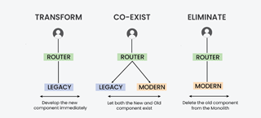
Strangler Pattern in Micro-services
The Strangler pattern is an architectural approach employed during the migration from a monolithic application to a microservices-based architecture. It derives its name from the way a vine slowly strangles a tree, gradually replacing its growth. Similarly, the Strangler pattern involves replacing parts of a monolithic application with microservices over time.
In order to implement strangler pattern, we need to follow 3 steps that are as follows:
Transform
Co-exists
Eliminate

Slide 60
Use Cases for the Strangler Pattern:
The Strangler pattern is primarily used when migrating from a monolithic architecture to microservices. It proves beneficial in scenarios where complete system rewrites pose significant risks and disruptions. This pattern is particularly suitable for legacy systems with complex codebases that are challenging to refactor entirely.

Slide 61
Features of the Strangler Pattern:
Gradual Migration: This pattern enables a step-by-step migration from a monolithic application to microservices. It allows organizations to replace specific functionality or modules incrementally.
Coexistence: During the migration process, the monolithic application and microservices coexist, ensuring uninterrupted system functionality.
Strangling Behavior: The Strangler pattern gradually replaces components or modules of the monolithic application with microservices, leading to the eventual replacement of the legacy system.

Slide 62
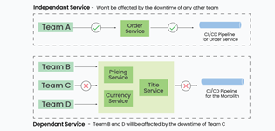
Implementation of Strangler Pattern:
Consider an e-commerce application with a monolithic architecture. To migrate the order management functionality to microservices using the Strangler pattern, follow these implementation steps:
Identify the order management functionality within the monolithic application.
Create an order management microservice.
Configure the API gateway to route order management requests to the microservice.
Migrate specific functionalities from the monolithic application to the microservice.
Repeat steps 1-4 until the monolithic application is fully replaced.

Slide 63
Advantages of Strangler Pattern
Incremental Migration: This pattern mitigates risks associated with complete system rewrites and minimizes disruptions by allowing a gradual migration process.
Flexibility: Organizations can independently refactor and update specific parts of the system based on business priorities.
Coexistence: The monolithic application and microservices coexist harmoniously, ensuring the system remains operational during the migration.

Slide 64
Drawbacks of Strangler Pattern
Complexity: The migration process can introduce complexity due to the coexistence and interaction between the monolithic application and microservices.
Data Consistency: Synchronizing data between the monolithic application and microservices can pose challenges, requiring careful management to ensure consistency.
Increased Network Calls: The introduction of microservices can lead to an increase in network calls, potentially impacting system performance and latency.
Dependency Management: Managing dependencies between the remaining monolithic components and new microservices requires proper versioning and dependency strategies to avoid conflicts.

Slide 65
Which components should be strangled or refactored first?
Playing it safe and choosing a straightforward component is not a bad choice if you are using the Strangler Pattern for the first time and are unfamiliar with this design pattern. This will make sure that before creating a complex component, you get real-world experience and familiarize yourself with the difficulties and best practices.
Starting with a component that has strong test coverage and little related technical debt can provide Teams a great deal of confidence during the migration process.
Start with a component that has scalability needs if there are any that are better suited for the cloud.

Slide 66
Which components should be strangled or refactored first?
Start with a component that needs to be deployed much more frequently due to frequent business requirements if there is one. You won't need to frequently again deploy the full monolithic application . You can scale and deploy the application independently if you divide it into a distinct process.
You will face numerous obstacles on your journey to migrate to the cloud. Due to the fact that you are dealing with small components at once, the Strangler design pattern helps you to make this journey somewhat smooth and risk-free. When you intend to complete the move in bits and pieces, it is not a difficult task.
You can provide Business features faster by reducing the complexity of an application. You may scale your application using the rising load feature as well.It is significantly simpler to deploy microservices and can result in a much smoother transition from monoliths to microservices if there is an automated CI/CD pipeline.

Slide 67
Event Sourcing

Slide 68
What is Event Sourcing?
The Event Sourcing Pattern is like keeping a detailed diary for your software. Instead of just updating the current state of your data, you record every change as a separate event. These events form a complete history of what happened to your data over time. Therefore, you may rebuild your data by replaying these events to find out how it got to where it is now.
These events are stored sequentially, forming a log or journal of actions that have occurred.
The status of the program can be restored at any moment by replaying these events.
It is frequently utilized in fields like finance and e-commerce where precise historical data are essential.

Slide 69
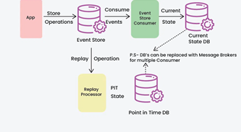
Event Sourcing

Slide 70
Core Concepts and Components of Event Sourcing
Events: These are permanent records of system state changes. In addition to representing a particular action or occurrence, each event includes all the relevant information required to rebuild the system's state at the moment of the event.
Event Store: The stream of events produced by the system is sustained by the event store, a robust data store. It guarantees that the sequence of events is maintained by storing them in the order in which they were received.
Aggregate: For the purposes of processing commands and producing events, an aggregate is a logical collection of linked domain objects that are handled as a single unit. The system's state changes and business logic are contained in aggregates. In the event store, each aggregate is linked to a distinct stream of events.

Slide 71
Core Concepts and Components of Event Sourcing
Command: Clients or other system components can issue commands, which are requests or instructions to carry out particular tasks. Aggregates process commands by validating them, applying business logic, and, if the command is approved, generating the appropriate events.
Projection: Projections are read models created from the stream of events kept in the event store that shows the system's current state. Projections are used to give effective access to data for reporting and querying.
Event Bus: An event bus is a messaging infrastructure that makes it easier for various system components to communicate about events. It enables components to respond asynchronously to particular event types and subscribe to them.

Slide 72
How Event Sourcing Pattern works?
Capture Events Instead of State: Every system modification is documented as an event (e.g., “order created,” “item added,” “order completed”) rather than just preserving the final state (e.g., “order is completed”). Every event denotes a distinct action or modification.
Store Events in Sequence: All events are stored in a sequence (often in a database or event store) in the exact order they occurred. This sequence of events acts as the "source of truth" for the system.
Reconstruct State by Replaying Events: When you need to know the current state, the system “replays” or processes all past events to build up the state from scratch.

Slide 73
How Event Sourcing Pattern works?
Handle New Events: As new changes happen, new events are created and added to the sequence. For instance, if an order is updated, a new event (e.g., “order updated”) is added to the sequence without changing or removing past events.
Replay Events for Debugging: If you need to see the history or investigate an issue, you can replay events to see how the state evolved over time. This replay ability makes it easy to understand the sequence of actions taken and trace any errors or issues.

Slide 74
Example of Event Sourcing Pattern
Registration System Before Event Sourcing
In a traditional event registration system, user registrations and cancellations are handled using a direct approach where the state is updated immediately in the database. This can lead to challenges such as difficulty in tracking changes, loss of historical data, and issues in notifying users when their registration status changes.
Below is the traditional registration class in which there are several issues:
When users register or cancel their registrations, the system updates the database immediately without maintaining a history of actions.
The system does not record the reasons for registration changes, making it hard to audit past actions.
Notifications to users must be handled separately, leading to potential delays and errors in communication.

Slide 75
Example of Event Sourcing Pattern
public class Registration {
private RegistrationState state;
private String userId;
private String eventId;
public void register(String userId, String eventId) {
this.state = RegistrationState.REGISTERED;
this.userId = userId;
this.eventId = eventId;
// Update the database directly
Database.update(this);
}
public void cancel() {
this.state = RegistrationState.CANCELLED;
// Update the database directly
Database.update(this);
}
}
In the code, When a user registers or cancels, the state is directly updated in the database, which may cause inconsistencies if issues arise during processing. Notifications to users are not integrated with the registration process, which may lead to missing or delayed alerts.

Slide 76
Example of Event Sourcing Pattern
2. Registration System Using Event Sourcing
With the move to an event-sourced architecture, the system now records each significant change as an event, allowing better tracking and historical analysis.
Instead of directly updating the database, the system processes commands to create and cancel registrations and generates events for each action.
Each state change is represented by an event, providing a clear audit trail of user actions.
Notifications are handled through event subscribers, ensuring users are promptly informed about their registration status changes.

Slide 77
Example of Event Sourcing Pattern
public class Registration extends ReflectiveMutableCommandProcessingAggregate<Registration, RegistrationCommand> {
private RegistrationState state;
private String userId;
private String eventId;
public RegistrationState getState() {
return state;
}
public List<Event> process(RegisterForEventCommand cmd) {
return EventUtil.events(new EventRegisteredEvent(cmd.getUserId(), cmd.getEventId()));
}
public List<Event> process(CancelRegistrationCommand cmd) {
return EventUtil.events(new RegistrationCancelledEvent(userId, eventId));
}
public void apply(EventRegisteredEvent event) {
this.state = RegistrationState.REGISTERED;
this.userId = event.getUserId();
this.eventId = event.getEventId();
}
public void apply(RegistrationCancelledEvent event) {
this.state = RegistrationState.CANCELLED;
}
}
By transitioning to an event-sourced architecture, the event registration system gains a clear advantage in tracking registration states, maintaining a complete history of actions, and ensuring timely notifications to users.

Slide 78
Benefits of Event Sourcing Pattern
By recording all system modifications, Event Sourcing builds an unalterable record of all activities.
With event sourcing, you can replay events up to a certain point in time to query the system's current state.
Event sourcing encourages adaptability and system development over time. New event types can be created to address changes in business requirements without affecting current components.
Event Sourcing is a good fit for distributed systems and horizontal scaling as events can be individually consumed and processed by several components, enhancing scalability and speed.

Slide 79
Challenges with Event Sourcing Pattern
Events may take on a different structure as the system develops. It becomes essential to manage event versioning and backward compatibility to guarantee seamless migrations and upgrades without erasing previous data.
It can be difficult to properly store and retrieve huge amounts of events, particularly in situations with high throughput or lengthy event histories. It becomes crucial to put in place efficient querying and event storing systems.
Various components of the system may see state changes at various times due to eventual consistency, which is usually the outcome of event sourcing. Handling stale data, resolving conflicts, and data synchronization all need careful thought when dealing with eventual consistency.

Slide 80
Use Cases and Applications of Event Sourcing
Financial Systems: To keep an unchangeable record of transactions, account activity, and compliance events, banking and financial institutions use event sourcing.
Healthcare Records: Electronic health record (EHR) systems use event sourcing to document patient contacts, treatment histories, and medical procedures.
Supply Chain Management: Event sourcing is used in supply chain and logistics management to track inventory movements, shipping updates, and supply chain interruptions.
E-commerce Platforms: Event sourcing is a useful tool for e-commerce applications to record customer interactions, order fulfillment processes, and inventory changes. This makes it feasible to track orders, offer customized recommendations, and examine customer behavior in order to boost sales and customer satisfaction.
Gaming and Virtual Environments: Event Sourcing is used in virtual worlds and multiplayer online games to record player movements, game state changes, and in-game purchases.

Slide 81
Real-World Example of Event Sourcing Pattern
Account Operations: The system creates related events whenever a consumer does an action that impacts their account, like making a deposit, taking money out of their account, moving money to another account, or changing personal data.
Event Logging: elevant details including the kind of operation, the amount involved, timestamps, and any additional metadata required to recreate the account's status are contained in each event.
Event Processing: These events are consumed by event handlers or processors, who then alter the status of the impacted accounts appropriately. For instance, the account balance is increased if a "Deposit" event is noted. The balance is reduced if a "Withdrawal" event is recorded.
Scalability and Resilience: Event Sourcing distributes event processing over several nodes, enabling the bank's system to scale horizontally. The system can recover by replaying events from the event storage to restore the status of accounts in the event of malfunctions or outages.

Slide 82
When to Use Event Sourcing Pattern
It's good for apps with complicated rules that need to keep track of how things change over time.
It helps when you need a complete history of changes for legal reasons or audits.
Useful for systems that need to save old data, like financial information.
Helps your app bounce back quickly from problems by replaying past events.
Works well in systems with separate parts (like microservices) that need to communicate without being tightly linked.

Slide 83
When not to Use Event Sourcing Pattern
Simple Applications: If an application just needs to track the most recent state and doesn't require a thorough history or audit trail, Event Sourcing may introduce needless complexity.
High Storage Costs: Event Sourcing stores every change as an event, which can lead to high storage costs, especially if there are frequent updates or changes.
Complex Data Consistency Needs: Managing consistency across multiple events can become challenging, especially when coordinating data between different services or systems.
Performance Sensitivity: Replaying events to rebuild the state can slow down performance in applications where quick data retrieval is essential.

Slide 84
API Gateway Pattern

Slide 85
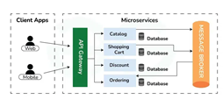
What is API Gateway?
An API gateway is a machine or service that sits on the edge of a system or network of microservices and serves as the entry point into the system. It is essentially a single point of entry for all client requests and serves several purposes:

Slide 86
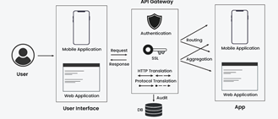
Key characteristics of API Gateway architecture include:
Routing and Load Balancing: API gateways perform this function in complex setups by routing API connections to the desired microservice or back-end services based on predefined rules. They also have the capability of delivering incoming requests across several service instances to achieve load balancing, therefore, attaining a high level of reliability and scalability.
Protocol Translation: In addition to API Gateways, there is a significant demand for the translation of different protocols and data formats. As an illustration, in case they would need to transmit HTTP request messages into messages formatted for a backend service with a disparate protocol like gRPC.

Slide 87
Key characteristics of API Gateway architecture include:
Request Transformation: API Gateways provide mechanisms to send outbound requests and inbound responses so they can be transformed according to the functionality specifications of the back-end services. These are duties like changing of request parameter, the transforming of request body/response body, adding or deleting headers, and so on.
Caching: An Application Programming Interface (API) Gateway Caching approach can make request and response wait times faster and latency smaller.

Slide 88
Benefits of using API Gateway in Microservices
Centralized Management: APIs Gateway present an entry point that clients reach to access micro-services. This gives an ease of operation and consistent mapping, as the trajectory of APIs and strategies for traffic management are all in the gateway and hence security policies, rates management and authentication become more manageable.
Improved Security: API Gateways play a key role in security for microservices as they act as a protection envelop that allow organizations to pass security measures such as authentication, authorization and encryption in a centralized way. They can pick work such as addressing things like API key management, OAuth token verification,and SSL termination, hence the security pressure of individual microservices is eased.

Slide 89
Benefits of using API Gateway in Microservices
Protocol Agnosticism: APIs can be used as a translator, and in this way, microservice clients can communicate with other systems using their preferred protocols. This flexibility is an added advantage to the audience that makes integration of different client applications and backend services possible without the need for them to support the same communication protocol.
Load Balancing and Scalability: Load Balancing and Scalability: Through APIs Gateways incoming requests are load-balanced across the farm of microservices instances to achieve high availability and scalability. They can freely modify rerouting rules, such as server health, request volume, geographic locations, in order to achieve the best performance.
Caching and Optimization: API gateway can exploit and cache responses from microservices, thus improving performance and shaving off latency. Through storing the data that is requested most, they enable a response that does not require much stress on backend systems and client applications. Furthermore, they make the optimization of requirements possible by combining or transforming data originating from multiple microservices to one single response, thus reducing the number of trips of clients and servers.

Slide 90
API Gateway Patterns with examples and uses in Microservices
1. Gateway Aggregation
API aggregation refers to the practice of combining or consolidating multiple APIs (Application Programming Interfaces) into a single interface or endpoint. This aggregated API typically provides access to the functionalities and data of multiple underlying APIs in a unified manner.
API aggregation allows developers to access the capabilities of several APIs through one single API.
Instead of interacting separately with each individual API, developers can make requests and receive responses from the aggregated API, which handles communication with the underlying APIs on their behalf.
For Example:
Imagine you're building an e-commerce platform where you need to integrate various services and functionalities from different providers to offer a comprehensive shopping experience. These functionalities may include product listings, payment processing, order tracking, and user authentication.
Instead of directly interacting with each provider's API separately, you can aggregate these APIs(Product Catalog API, Payment Gateway API, Shipping and Logistics API, User Authentication API) into a single interface within your e-commerce platform.

Slide 91
Use Cases of Gateway Aggregation
Unified API Endpoint: Combining multiple backend services into one API endpoint simplifies client integration.
Reduced Network Overhead: Aggregating requests minimizes network round-trips, improving performance.
Caching and Optimization: Gateway caching enhances response times and reduces backend load.
Security and Governance: Centralized gateway enforces security measures and access controls consistently.
Fault Tolerance and Resilience: Implement retry mechanisms and fallback strategies to handle service failures effectively.

Slide 92
API Gateway Patterns with examples and uses in Microservices
2. Gateway Offloading
Gateway offloading is a practice in microservices architecture where certain tasks or responsibilities are shifted away from the individual microservices and delegated to a centralized gateway or proxy. This offloading helps optimize the performance and scalability of the microservices ecosystem by reducing the burden on individual services.
In microservices architecture, individual services often handle tasks such as authentication, rate limiting, and request validation internally.
However, as the number of services grows, these tasks can become complex and resource-intensive. Gateway offloading addresses this challenge by offloading these tasks to a centralized gateway.
For Example:
Imagine you have a microservices-based e-commerce platform with multiple services handling different functionalities. Instead of each service independently managing tasks like authentication and request validation, you can offload these responsibilities to a centralized gateway.

Slide 93
Use Cases of Gateway Offloading:
Authentication and Authorization: Centralizing authentication and authorization logic in the gateway simplifies implementation and ensures consistent security measures across all services.
Rate Limiting and Throttling: Offloading rate limiting and throttling to the gateway helps prevent service overload and ensures fair resource allocation.
Request Validation: Validating incoming requests at the gateway level ensures that only well-formed and authorized requests are forwarded to the microservices, reducing the risk of malicious attacks and service disruptions.
Static Content Serving: The gateway can handle serving static content such as images, CSS, and JavaScript files, offloading this task from individual services and improving overall performance.
Load Balancing: Centralized load balancing at the gateway ensures optimal distribution of incoming requests across multiple instances of microservices, improving reliability and scalability.

Slide 94
API Gateway Patterns with examples and uses in Microservices
3. Gateway Routing
Gateway routing refers to the process of directing incoming requests to the appropriate backend services based on predefined routing rules. In a microservices architecture, a centralized gateway or proxy is responsible for inspecting incoming requests and forwarding them to the corresponding microservice based on factors such as the request path, HTTP headers, or other metadata.
For Example:
Consider a microservices-based e-commerce platform with separate services for product catalog, order management, and user authentication. When a user requests to view product details, the gateway inspects the request and forwards it to the product catalog service. Similarly, a request to place an order is routed to the order management service.

Slide 95
Use Cases of Gateway Routing:
Service Discovery: Gateway routing facilitates dynamic service discovery by automatically routing requests to available instances of backend services, regardless of their locations or configurations.
Path-Based Routing: Routing requests based on the URL path allows for logical separation of functionalities and simplifies the management of routing rules.
Header-Based Routing: Routing requests based on HTTP headers enables more fine-grained control over routing decisions, such as directing requests to different versions or environments of a service.
Load Balancing: Gateway routing can include load-balancing strategies to evenly distribute incoming requests across multiple instances of the same microservice, ensuring optimal resource utilization and performance.
Traffic Shaping: By configuring routing rules, traffic shaping techniques such as A/B testing or canary deployments can be implemented at the gateway level to control the flow of traffic to specific microservice versions or features.

Slide 96
API Gateway Patterns with examples and uses in Microservices
Gateway Transformation
Gateway transformation involves modifying the structure or content of incoming requests or outgoing responses as they pass through a centralized gateway or proxy. This transformation allows for adaptation between different communication protocols, data formats, or versions, ensuring compatibility and consistency between clients and backend services within a microservices architecture.
For Example:
Consider a scenario where a client application sends a request to retrieve user information in JSON format, but the backend service expects XML-formatted requests. The gateway intercepts the incoming request, transforms it from JSON to XML, forwards it to the backend service, receives the response in XML format, and transforms it back to JSON before returning it to the client.

Slide 97
Use Cases of Gateway Transformation:
Protocol Conversion: Gateway transformation enables converting requests and responses between different communication protocols such as HTTP, WebSocket, or gRPC, ensuring interoperability between clients and backend services.
Data Format Conversion: Transforming requests and responses between different data formats such as JSON, XML, or Protocol Buffers allows for compatibility between heterogeneous systems and services.
Versioning: Gateway transformation supports versioning of APIs by modifying requests or responses to adhere to specific API versions, enabling smooth migration and backward compatibility.
Content Enrichment: Adding or augmenting information in requests or responses, such as injecting additional metadata or computed fields, enhances the richness and usability of data exchanged between clients and services.

Slide 98
API Gateway Patterns with examples and uses in Microservices
5. Gateway Security
Gateway security refers to the implementation of security measures within a centralized gateway or proxy to protect microservices and their interactions from unauthorized access, data breaches, and other security threats. The gateway acts as a first line of defense, enforcing security policies, access controls, and threat mitigation strategies to safeguard the microservices ecosystem.
For Example:
Consider an e-commerce platform where sensitive user information, payment details, and order data are exchanged between clients and backend services. The gateway implements security measures such as SSL/TLS encryption, OAuth-based authentication, role-based access control (RBAC), and input validation to protect against unauthorized access, data breaches, and malicious attacks.

Slide 99
Use Cases of Gateway Security:
Authentication and Authorization: The gateway authenticates clients and authorizes access to backend services based on predefined security policies, user roles, and permissions.
Encryption: Gateway security ensures end-to-end encryption of data in transit using protocols such as SSL/TLS to protect sensitive information from interception and eavesdropping.
Input Validation: The gateway performs input validation and sanitization to prevent common security vulnerabilities such as SQL injection, cross-site scripting (XSS), and command injection attacks.
Rate Limiting and Throttling: Gateway security enforces rate limiting and throttling to mitigate denial-of-service (DoS) attacks and prevent service overload by limiting the number of requests from clients.
Security Headers: The gateway adds security headers to HTTP responses, such as Content Security Policy (CSP) and Cross-Origin Resource Sharing (CORS), to prevent clickjacking, cross-site scripting (XSS), and other web security vulnerabilities.

Slide 100
Saga Design Pattern

Slide 101
What is a Distributed Transaction?
A distributed transaction refers to a type of transaction that involves multiple, separate systems or databases, often spread across different locations or networks, which need to work together to complete a task. It’s like a coordinated team effort, where each system handles a small part of the work, but they all must complete their respective tasks successfully for the overall transaction to be considered successful.
For example, imagine you're making an online purchase. The transaction might involve:
Your bank checks if you have enough funds.
The e-commerce platform reserving the product you're buying.
A shipping service getting ready to send your item.
A warehouse updating its stock levels

Slide 102
What is 2PC for Distributed Transaction Management?
2PC (Two-Phase Commit) is a protocol used to ensure all participants in a distributed transaction either commit or abort, ensuring consistency. In the first phase, the coordinator asks all participants to agree to commit, and in the second phase, participants either vote to commit or abort the transaction.

Slide 103
Problems with Traditional Distributed Transaction Protocols
Traditional distributed transaction protocols like Two-Phase Commit (2PC) have limitations in modern systems, primarily due to:
Blocking Nature: If the coordinator fails after initiating the transaction, participants may be left waiting indefinitely, causing delays.
Single Points of Failure: The coordinator is crucial for decision-making. If it crashes, the entire transaction can get stuck, impacting reliability.
Network Partitions: If the network splits, some nodes might not receive the final decision, leading to inconsistent states (i.e., some nodes might commit while others don’t), which causes data inconsistency.
These problems make 2PC unsuitable for modern, highly available, and fault-tolerant systems.

Slide 104
What is the SAGA Design Pattern?
The SAGA Design Pattern is a pattern used to manage long-running, distributed transactions in a microservices architecture.
Instead of relying on traditional, monolithic transactions (which require locking databases across services), the SAGA pattern breaks the transaction into a series of smaller, independent operations that each belong to a different service.
These smaller operations, also called saga steps, are executed sequentially or in parallel, with each step compensating for potential failures in the others.

Slide 105
Why do we need SAGA Design Pattern?
SAGA is needed because 2PC, while simple, doesn't work well in distributed systems where availability and fault tolerance are critical. In real-world systems, network failures, crash recovery, and long-running transactions are common, and 2PC's blocking behavior and reliance on a single coordinator can make the system unreliable and slow. SAGA provides a more flexible, decentralized approach to managing long-running distributed transactions.
SAGA addresses the limitations of 2PC by breaking a transaction into smaller, independent steps, each with its own compensating action if something goes wrong. Here's how it solves key issues of 2PC:
No Blocking: Unlike 2PC, which blocks participants until the transaction is complete, SAGA allows each step to execute independently, avoiding delays due to coordinator failure.

Slide 106
Why do we need SAGA Design Pattern?
No Single Point of Failure: SAGA doesn’t rely on a central coordinator. Each step is independent, so if one step fails, it doesn't block the entire process.
Graceful Failure Handling: Instead of rolling back the entire transaction (as in 2PC), SAGA uses compensating actions to undo successful steps if a failure occurs, ensuring the system remains consistent.
Resilience to Network Partitions: SAGA can continue even if parts of the network fail, because each step is independent, and compensating actions can be executed later when the partition resolves.

Slide 107
How SAGA Design Pattern Works?
The SAGA Design Pattern manages long-running distributed transactions by breaking them into smaller steps, each with its own compensating action in case of failure. Here’s how it works:
Breaking Down the Transaction: A big transaction is divided into smaller, independent sub-transactions (steps), each handled by different services. For example, reserving a product, charging the customer, and shipping the item.
Independent Execution: Each step runs independently without waiting for the others to finish. If a step succeeds, the next step proceeds.
SAGA Execution Coordinator: The SAGA Execution Coordinator manages and coordinate the flow of these steps, triggering each one in sequence.
Compensating Actions: If any step fails, the system doesn’t roll back everything. Instead, it executes compensating actions to undo the work done in previous successful steps, like refunding a payment or canceling a reservation.
SAGA Log: Helps manage and track the state of a long-running distributed transaction, ensuring that all steps are completed successfully or properly compensated in case of failure.

Slide 108
Example of SAGA Design Pattern
Let's understand how SAGA works using the example of an e-commerce order process with the SAGA Execution Coordinator and SAGA Log.
Step 1: Create Order: Reserve the product.
Step 2: Process Payment: Charge the customer’s card.
Step 3: Update Inventory: Reduce the stock.
Step 4: Deliver Order: Ship the product to the customer.

Slide 109
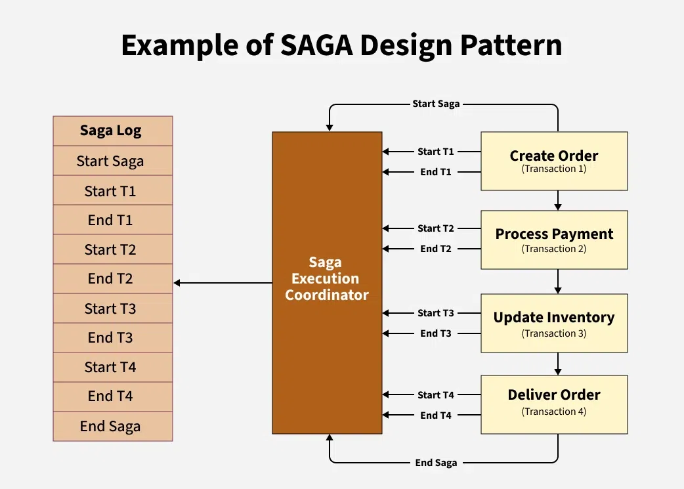
How It Works:
The SAGA Execution Coordinator manages the flow of these steps, triggering each one in sequence.
Each step has a compensating action that is triggered if something goes wrong (e.g., if payment fails, the product is unreserved).
The SAGA Log tracks the state of each step. It logs each step as in-progress, completed, or failed, and records any compensating actions needed.

Slide 110
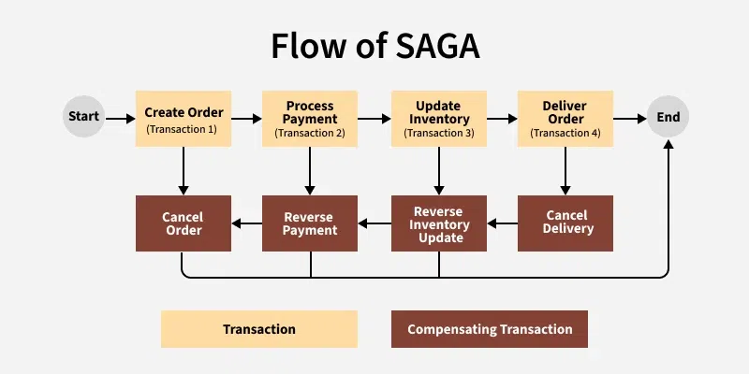
Flow of SAGA:
Start the SAGA:
The process begins by executing the first step in the sequence.
Execute Step 1:
The system performs the first sub-transaction (e.g., creating the order and reserving the product). If this step is successful, move to Step 2. If it fails, trigger its compensating action (e.g., cancel the order) and stop.
Execute Step 2:
If Step 1 was successful, the next step (e.g., process the payment) is executed. If Step 2 fails (e.g., payment is declined), its compensating action (e.g., refund the payment) is triggered, and Step 1’s compensating action (e.g., unreserve the product) is also executed.
Execute Step 3:
If Step 2 was successful, proceed to the next step (e.g., update inventory). If Step 3 fails, its compensating action (e.g., reverse inventory update) is triggered, and Step 2’s compensating action (e.g., refund payment) is executed.
Execute Step 4:
Finally, if all previous steps are successful, the last step (e.g., deliver the order) is executed. If any prior step has failed, its compensating actions are triggered, ensuring the system remains consistent.

Slide 111
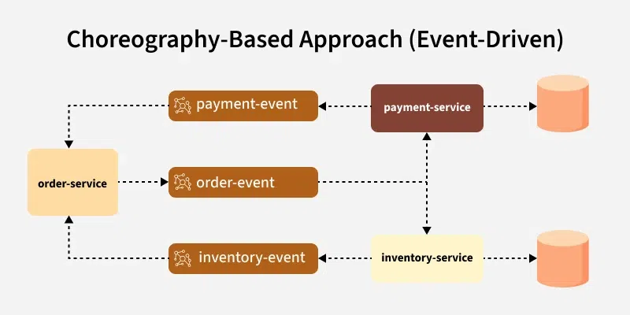
Approaches to Implemement SAGA Design Pattern
1. Choreography-Based Approach (Event-Driven)
There is no central coordinator; each service knows what to do next and triggers the next step by emitting events.
Services communicate through events (e.g., via message queues or event streams). Each service listens for events and performs its own action when the event occurs.
Services operate independently and don’t need to know about each other’s details, just the events they need to react to.
If a service fails, it publishes a failure event, and other services can listen to it and perform compensating actions.

Slide 112
Choreography-Based Approach (Event-Driven)
Example:
Order Service creates an order and publishes the "OrderCreated" event.
Payment Service listens for "OrderCreated" and processes payment, publishing "PaymentProcessed".
Inventory Service listens for "PaymentProcessed" and updates inventory, and so on.

Slide 113
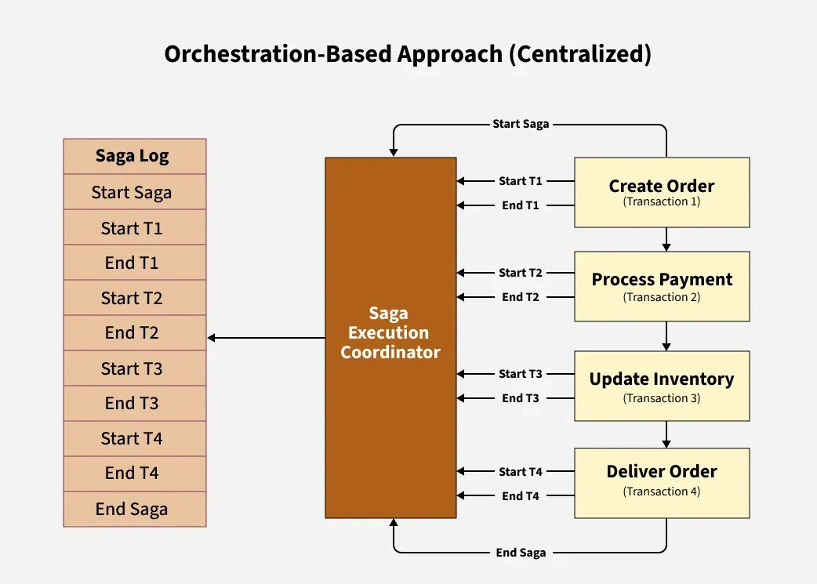
Approaches to Implemement SAGA Design Pattern
2. Orchestration-Based Approach (Centralized)
A single SAGA Execution Coordinator (orchestrator) controls the flow of the entire saga.
The orchestrator tells each service when to start, what to do, and when to proceed to the next step.
The orchestrator has detailed knowledge of each service and their responsibilities in the saga.
The orchestrator manages failure recovery and calls the compensating actions if needed.

Slide 114
Orchestration-Based Approach (Centralized)
The SAGA Execution Coordinator starts the saga and tells the Order Service to create the order.
Once the Order Service succeeds, the orchestrator tells the Payment Service to process the payment, and so on.

Slide 115
Advantages and Disadvantages of SAGA Pattern
Advantages of SAGA Pattern
Disadvantages of SAGA Pattern
With SAGA, if one step fails, the entire process can be rolled back or compensated without affecting other steps.
SAGA provides a clear and standardized way to handle errors and compensations, making it easier to debug and maintain.
SAGA can support asynchronous processing, allowing for greater concurrency and performance.
Implementing SAGA requires additional coding and architecture to handle compensation and rollback steps.
Not all frameworks or platforms support SAGA out of the box, which can make implementation more difficult.
The SAGA pattern requires careful design to ensure that the compensations and rollbacks are implemented correctly and can handle all possible failure scenarios.

Slide 116
Advantages and Disadvantages of SAGA Pattern
Advantages of SAGA Pattern
Disadvantages of SAGA Pattern
SAGA can handle transactions across multiple services or databases, allowing for more scalable and distributed architectures.
SAGA may result in additional latency due to the need to coordinate between different services or databases.

Slide 117
Externalized Configuration

Slide 118
Challenges of Configuration Management in a Microservices Environment
With many microservices, each one may require endpoints for other services, database credentials, feature flags, or performance parameters.
Hardcoding this configuration into the service’s codebase poses security risks (e.g., exposing secrets) and maintainability challenges (changes require redeployments).
Working across multiple environments (dev, test, staging, production) further multiplies configuration complexity.

Slide 119
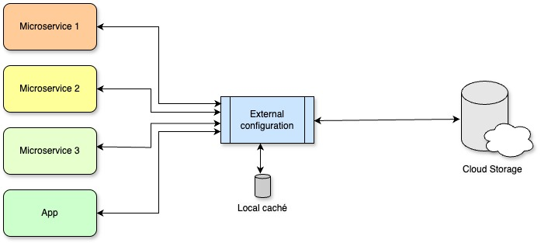
Externalized Configuration

Slide 120
Externalized Configuration
Pattern Fundamentals
Externalized configuration is based on the principle that all variable or sensitive service information should live outside the binary itself. That means credentials, payment gateway tokens, dependency URLs, or business parameters should not be embedded in the source code or internal config files—they should be injected at deploy time, or ideally, managed by a separate service.

Slide 121
Key Benefits
Security and Governance
Reduces the chance of secrets or API keys being committed to public repos or build logs.
Easier to apply access controls and audit changes.
Deployment Flexibility
A single Docker image (or JAR package) can move through the pipeline from dev → test → staging → prod, with the appropriate configuration injected at each step.
Parameters can be changed without recompiling, saving time and reducing errors.
Maintainability and Scalability
With dozens or hundreds of microservices, a shared configuration repository (or config service) simplifies orchestrating and updating shared values (like a common service URL).

Slide 122
Methods to Externalize Configuration
Environment Variables
In containerized environments (Docker, Kubernetes), this is the most basic and 12-Factor App–aligned method.
Each microservice retrieves its values at runtime.
Easy to manage with orchestrators (Kubernetes ConfigMaps and Secrets), though scalability may become an issue with many properties.

Slide 123
Methods to Externalize Configuration
Advantages of Enviornment Variable:
Simple to use and manage in containerized environments.
Fully aligned with the 12-Factor principle.
Limitations of Enviornment Variable:
Managing a large number of properties becomes cumbersome.
Containers do not support native dynamic reloading (a "rolling update" is required when environment variables change).

Slide 124
Methods to Externalize Configuration
Versioned external files
Another option is to store parameters in configuration files (YAML, JSON, Properties) located outside the service’s main folder, but still accessible at runtime.
These files can be mounted as a volume in Docker containers, downloaded at deployment time from an independent Git repository (GitOps), and integrated with frameworks (Spring Boot allows importing additional files with spring.config.additional-location).
Advantages:
Easy to use and read, with support for merging and Spring profiles (e.g., application-dev.yml, application-prod.yml).
Simple versioning in Git, allowing rollback if something goes wrong.
Disadvantages:
Requires a manual or automated process to distribute these files to each node.
Handling secrets isn’t always straightforward (you must encrypt them or restrict access).

Slide 125
Methods to Externalize Configuration
Centralized Configuration Services
For large microservice ecosystems, a configuration server becomes a key component. Some popular tools include:
Spring Cloud Config:
Acts as a bridge between microservices and a Git repository (or other backends).
The microservice starts up and contacts the Config Server, which provides the appropriate properties based on its application name and profile (application-name, dev/prod, etc.).
Supports dynamic reloading (if you use Spring Cloud’s Bus and Actuator) and full Git versioning.

Slide 126
Methods to Externalize Configuration
HashiCorp Vault:
Focused on secret management (keys, passwords, tokens).
Provides data encryption, access control policies (ACL), and in some cases, dynamic credential generation (e.g., temporary DB credentials).
Integrates with Java apps, Kubernetes, and more.
Consul:
In addition to key/value configuration storage, provides service discovery.
Can be paired with Vault for encrypted value storage.

Slide 127
Methods to Externalize Configuration
Advantages:
Centralization and scalability: microservices don’t need to "know" where their config is, just the config service endpoint.
Auditing and traceability: changes are logged and role-controlled.
Dynamic updates (hot reload) without redeployments (especially with Spring Cloud Config).
Disadvantages:
Adds complexity and requires maintaining the config server.
Must have a high availability plan to avoid creating a single point of failure.

Slide 128
Benefits of Externalized Configuration
Lower risk of leaks: by not storing secrets in code repositories, the chances of exposing sensitive data are greatly reduced.
Multi-environment deployments: a single binary of orders-service can run in dev, test, or prod without additional recompilation.
Change traceability: with Git repositories or config services, there is always a history of who changed what and when.
Hot reload and scalability: especially with Spring Cloud Config, it's possible to update the config on the fly and scale pods without each having a different set of properties.

Slide 129
General Best Practices
Adopt a "Secure by Design" approach. For externalized configuration, especially protect sensitive data using Vault, Kubernetes Secrets, or strong encryption.
Version your APIs. CDCT doesn’t eliminate the need to version endpoints when introducing breaking changes. For example, maintain /v1/pay and /v2/pay in payment-service, allowing consumers to migrate gradually.
Maintain team communication. CDCT's success relies on collaboration; it’s not a substitute for communication but a catalyst to discuss contracts objectively.
Automate the pipeline. Config collection and contract verification should run in every build process, not just before a release.

Slide 130
Command Query Responsibility Segregator

Slide 131
What is the CQRS Design Pattern?
CQRS stands for Command Query Responsibility Segregation, which is a design pattern used in software engineering to separate the responsibilities of handling commands (changing state) from the responsibility of querying data.
This pattern splits the responsibility of handling commands that change data from handling queries that retrieve data in software systems.
This separation allows for more flexibility and scalability in managing complex operations. In a system following the CQRS pattern, commands are responsible for modifying the state of the system, while queries are responsible for retrieving data from the system.

Slide 132
Principles and Concepts of CQRS Design Pattern in Microservices
Service Boundary: Each microservice defines a clear boundary around a specific business capability or domain. This boundary encapsulates both the command and query responsibilities related to that domain.
Separation of Concerns: CQRS emphasizes separating the responsibilities of handling commands (write operations) from handling queries (read operations). Each microservice focuses on either handling commands or handling queries, but not both.
Independent Scaling: Since commands and queries often have different performance characteristics and scalability requirements, CQRS allows microservices to be independently scaled based on the workload they handle. For example, a microservice responsible for processing high-frequency commands may be scaled independently from a microservice focused on handling complex queries.

Slide 133
Principles and Concepts of CQRS Design Pattern in Microservices
Domain-Driven Design (DDD): CQRS is often applied in conjunction with Domain-Driven Design principles. DDD helps in identifying bounded contexts, aggregates, and domain entities, which can then be mapped to microservices following the CQRS pattern.
Event-Driven Architecture: Event-driven architecture complements CQRS by enabling communication between microservices and maintaining consistency across distributed systems. Events can be used to notify other microservices about changes in state resulting from command execution

Slide 134
Separation of Concerns of CQRS Design Pattern in Microservices
Command Responsibility:
Write Operations: Microservices responsible for handling commands focus on managing data modifications. They receive requests to perform actions that change the system's state, such as creating, updating, or deleting data.
Validation and Business Logic: Command microservices enforce business rules and validate incoming requests to ensure data integrity and consistency.
Transactional Behavior: Commands often execute within transactional boundaries to guarantee atomicity, consistency, isolation, and durability (ACID properties).

Slide 135
Separation of Concerns of CQRS Design Pattern in Microservices
Query Responsibility:
Read Operations: Microservices dedicated to handling queries focus on retrieving data from the system. They respond to requests for information without altering the system's state.
Optimized Data Retrieval: Query microservices optimize data storage and retrieval mechanisms for efficient read operations. This may involve denormalizing data, employing caching strategies, or using specialized query languages.
Scalability: Query microservices may be scaled independently based on the read workload, allowing for efficient resource allocation and performance optimization.

Slide 136
Separation of Concerns of CQRS Design Pattern in Microservices
Communication and Coordination:
Command-Query Separation: Clear boundaries exist between microservices handling commands and those handling queries, preventing overlap and ensuring each service has a well-defined responsibility.
Asynchronous Communication: Command and query microservices may communicate asynchronously, allowing for decoupled interactions and fault tolerance. Asynchronous messaging systems or event-driven architectures facilitate communication between services.
Eventual Consistency: Asynchronous communication can lead to eventual consistency between the command and query sides. Microservices must handle eventual consistency scenarios gracefully, ensuring data correctness and minimizing user impact.

Slide 137
Separation of Concerns of CQRS Design Pattern in Microservices
Domain Modeling:
Domain-Driven Design (DDD): Microservices align with domain boundaries defined by DDD principles. Each microservice encapsulates a specific domain or business capability, ensuring cohesive behavior and encapsulation of domain logic.
Bounded Contexts: Microservices define bounded contexts within the domain, delineating areas where different rules and definitions apply. This ensures clarity and separation of concerns within complex domains.

Slide 138
Key Components of CQRS Design Pattern in Microservices
Command Service:
Command Handlers: Responsible for receiving, validating, and executing commands that change the state of the system.
Domain Logic: Implements business rules and domain-specific logic required to process commands.
Transactional Behavior: Ensures atomicity, consistency, isolation, and durability (ACID properties) of command execution.
Query Service:
Query Handlers: Retrieve data from the system in response to read requests without modifying the state.
Optimized Data Access: Utilizes efficient data retrieval mechanisms, such as denormalization, caching, or indexing, to optimize query performance.
Scalability: Scales independently to handle varying read workloads efficiently.

Slide 139
Key Components of CQRS Design Pattern in Microservices
Event Bus or Message Broker:
Asynchronous Communication: Facilitates communication between command and query services through events or messages.
Publish-Subscribe Mechanism: Allows command services to publish events representing state changes, which query services can subscribe to for eventual consistency.
Decoupling: Enables loose coupling between services, promoting flexibility, and fault tolerance.
Data Stores:
Write Store (Command Side): Optimized for handling write operations, such as inserts, updates, and deletes. May use NoSQL databases for scalability and performance.
Read Store (Query Side): Optimized for efficient data retrieval. May use relational databases for complex queries or specialized data stores for specific use cases.

Slide 140
Key Components of CQRS Design Pattern in Microservices
API Gateway or Service Mesh:
Entry Point: Provides a single entry point for clients to interact with the microservices architecture.
Routing and Load Balancing: Routes requests to the appropriate command or query services and balances the load across instances.
Security and Authentication: Enforces security policies, authentication, and authorization mechanisms.

Slide 141
Advantages of CQRS Design Pattern in Microservices
Scalability:
Independent Scaling: Command and query services can be scaled independently based on the workload they handle. This allows for better resource allocation and improved performance as each service can be optimized for its specific responsibilities.
Performance Optimization:
Optimized Data Access: Command and query services can use separate data storage mechanisms optimized for their respective operations. For example, command services may use a NoSQL database for fast write operations, while query services may use a relational database for complex queries.
Efficient Read Operations: Query services can denormalize data, use caching strategies, or employ specialized data stores to optimize read operations and improve response times.

Slide 142
Advantages of CQRS Design Pattern in Microservices
Flexibility and Maintainability:
Separation of Concerns: CQRS separates the responsibilities of handling commands (write operations) from handling queries (read operations). This separation makes it easier to understand, maintain, and evolve the system over time.
Modularity: Each microservice in a CQRS architecture encapsulates a specific business capability or domain, making it easier to update or replace individual services without impacting the entire system.
Improved Performance and Responsiveness:
Reduced Blocking Operations: Separating read and write operations reduces contention and blocking, leading to better responsiveness and overall system performance.
Asynchronous Communication: CQRS often involves asynchronous communication between services, which can improve responsiveness by decoupling command execution from query processing.

Slide 143
Challenges of CQRS Design Pattern in Microservices
Increased Complexity:
Architectural Complexity: Implementing CQRS introduces additional architectural complexity, including the need for separate command and query paths, event sourcing, and eventual consistency mechanisms.
Development Complexity: Developing and maintaining separate codebases for command and query services can increase development overhead, especially for teams not familiar with the pattern.
Consistency Management:
Eventual Consistency: Maintaining eventual consistency between the command and query sides can be challenging, especially in distributed systems with high concurrency and data replication delays.
Synchronization Issues: Ensuring that data updates propagated by commands are reflected accurately in query results requires careful synchronization mechanisms and handling of race conditions.

Slide 144
Challenges of CQRS Design Pattern in Microservices
Data Synchronization:
Data Duplication: CQRS often involves duplicating data between command and query models, leading to increased storage requirements and complexity in keeping data synchronized.
Data Integrity: Maintaining data integrity across multiple data stores and ensuring consistency between them can be challenging, especially during system failures or network partitions.
Operational Overhead:
Infrastructure Management: Managing the infrastructure required for running separate command and query services, including deployment, monitoring, and scaling, can introduce additional operational overhead.
Monitoring and Debugging: Debugging and monitoring a CQRS-based microservices architecture require specialized tools and techniques to trace command and event flows and diagnose consistency issues.

Slide 145
How CQRS is implemented in microservices?
Step 1: Identify Bounded Contexts:
Define bounded contexts within the domain where different rules and definitions apply. Each bounded context may correspond to a microservice boundary in the architecture.
Step 2: Separate Command and Query Paths:
Designate specific microservices to handle commands (write operations) and others to handle queries (read operations). Ensure clear separation of concerns between these two paths.
Step 3: Implement Command Services:
Create microservices responsible for handling commands. These services receive command requests, validate them, execute the necessary actions to change the system's state, and publish events representing state changes.
Step 4: Implement Query Services:
Develop microservices dedicated to handling queries. These services retrieve data from the system in response to read requests, ensuring efficient data access and optimization for read operations.

Slide 146
How CQRS is implemented in microservices?
Step 5: Define APIs:
Design clear and consistent APIs for command and query services, specifying the types of operations they support and the data formats they accept and return.
Step 6: Choose Data Storage Mechanisms:
Select appropriate data storage mechanisms for command and query services based on their specific requirements. For example, command services may use NoSQL databases optimized for write operations, while query services may use relational databases for complex querying.
Step 7: Establish Asynchronous Communication:
Implement asynchronous communication mechanisms between command and query services, such as message brokers or event buses. This allows command services to publish events representing state changes, which query services can subscribe to for eventual consistency.

Slide 147
How CQRS is implemented in microservices?
Step 8: Handle Eventual Consistency:
Develop mechanisms to handle eventual consistency between command and query services. This may involve implementing reconciliation processes, compensating transactions, or using techniques like event replay to maintain consistency over time.

Slide 148
Real-world Use Cases of CQRS Design Pattern in Microservices
E-commerce Platforms:
Financial Systems:
Content Management Systems (CMS):
Internet of Things (IoT) Applications:
Online Gaming Platforms:
Supply Chain Management Systems:
Healthcare Applications:

Slide 149
Design Guidelines for CQRS Design Pattern in Microservices
When implementing the CQRS (Command Query Responsibility Segregation) pattern in a microservices architecture, consider the following design guidelines:
Clear Separation of Concerns:
Clearly define the responsibilities of command and query services. Command services handle write operations, while query services handle read operations. Ensure that each service has a well-defined and cohesive purpose.
Domain-Driven Design (DDD) Alignment:
Align the microservices architecture with domain-driven design principles. Identify bounded contexts, aggregates, and domain entities, and map them to individual microservices following the CQRS pattern.
Granular Service Boundaries:
Define fine-grained service boundaries based on business capabilities or domain contexts. Avoid creating monolithic services that handle both commands and queries, as this can lead to complexity and coupling.
API Design:
Design clear and consistent APIs for command and query services. Use descriptive and meaningful endpoint names, and define data formats and request/response structures that are intuitive and easy to use.

Slide 150
Tools and Frameworks Available in CQRS Design Pattern
Axon Framework
EventFlow
Lagom
Akka
Spring Framework

Slide 151
Real life example of CQRS Design Pattern in Microservices
A real-life example of the CQRS (Command Query Responsibility Segregation) pattern in a microservices architecture can be found in an e-commerce platform. Let's consider an online bookstore:

Slide 152
Real life example of CQRS Design Pattern in Microservices
Command Services:
Order Service: Responsible for handling commands related to order management.
Commands include creating new orders, updating order status, and processing payments.
This service ensures that orders are validated, processed, and persisted in the database.
Inventory Service: Responsible for managing commands related to inventory management.
Commands include adding or subtracting inventory stock for books, updating product availability, and handling backorders.
This service ensures that inventory changes are accurately reflected in the system and updates inventory levels accordingly.

Slide 153
Real life example of CQRS Design Pattern in Microservices
Query Services:
Product Catalog Service: Responsible for handling queries related to the product catalog.
Queries include retrieving book information, searching for books by title or author, and listing available products.
This service provides fast and efficient access to product data for displaying on the website or mobile app.
Order History Service: Responsible for handling queries related to order history and customer profiles.
Queries include retrieving order details, viewing order history, and managing user profiles.
This service provides customers with access to their past orders and allows them to track order status.

Slide 154
Real life example of CQRS Design Pattern in Microservices
Event-Driven Architecture:
Event Bus: Events are used to communicate changes between command and query services.
When a new order is placed (command), an event is published indicating the order creation.
Query services subscribe to relevant events and update their read models accordingly, ensuring eventual consistency between command and query sides.
Data Storage:
Write Store (Command Side): Uses a database optimized for write operations, such as a relational database or a NoSQL database.
Command services store data related to orders, inventory changes, and other write operations.
Read Store (Query Side): Uses a separate database optimized for read operations.
Query services maintain denormalized views or projections of data for fast query performance.

Slide 155
Real life example of CQRS Design Pattern in Microservices
API Gateway:
Entry Point: An API gateway serves as the entry point for client applications to interact with the microservices architecture.
It routes requests to the appropriate command or query services based on the operation being performed.

Slide 156
Thank you!

